Slide 1


Pothole Detection
Abdullah Altamimi
Saad Alkathiri
Nawaf Alomeir

Slide 2

objective
Real-Time Detection: Implement YOLO for immediate pothole identification in images or video streams.
Enhanced Safety: Automate the detection process to improve road safety and maintenance efficiency.
Timely Information: Provide accurate data for quicker road repair and monitoring.

Slide 3

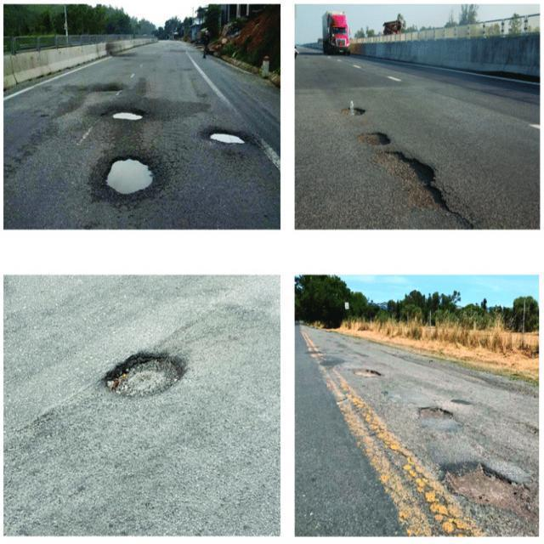
Data Collection
Total Size: 6810 images
Training: 4749 images (70%)
Validation : 1394 images (20%)
Test: 667 images (10%)

Slide 4

Model selection
YOLOv8 is chosen for:
High Accuracy
Speed
Flexibility
Ease of Use

Slide 5
Model Evaluation
Class Name | Precision | Recall | MAP50
Pothole | 0.972 | 0.964 | 0.983

Slide 6
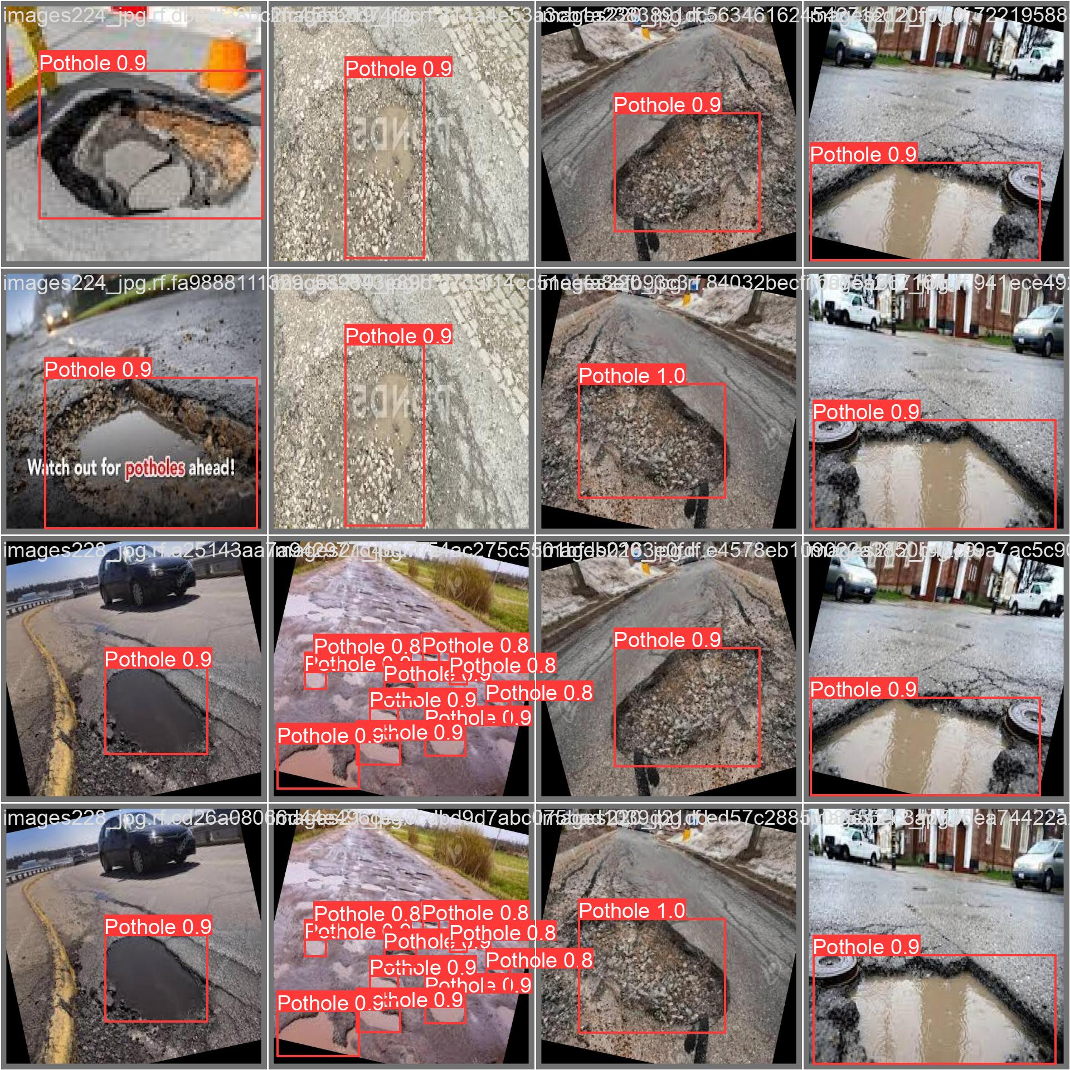
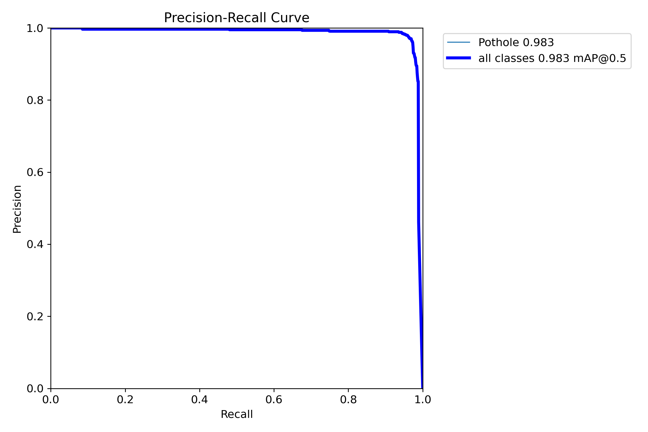
Model Evaluation

Slide 7
Task Assignment
Name | Tasks
Abdullah Altamimi | Model Architecture , Evaluation
Saad Alkathiri | Deployemnt
Nawaf Alomeir | Data collection

Slide 8

Deployment

